Slide 1


Slide 2

Data Collection Techniques

Slide 3

Acquiring Users for Data Collection
The brands we work with provide an email list and an incentive.
We use a brand’s email system and embed tracking information that follows the user through the entire process.
The incentive can be distributed by the brand or by Datalucent via the brand’s email system.
We completely white label the process and the user is never aware of Datalucent.

Slide 4

Step 1: Logging in With Social
The process begins with the user selecting a social media platform to use with our system.
We currently support Facebook and Twitter, with Google, Instagram and more to follow.

Slide 5
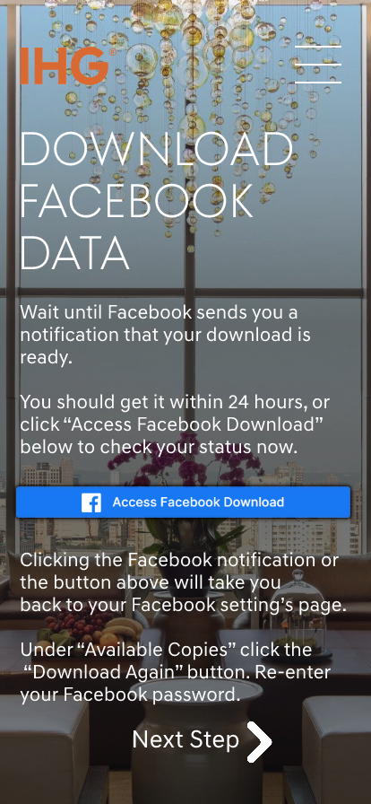
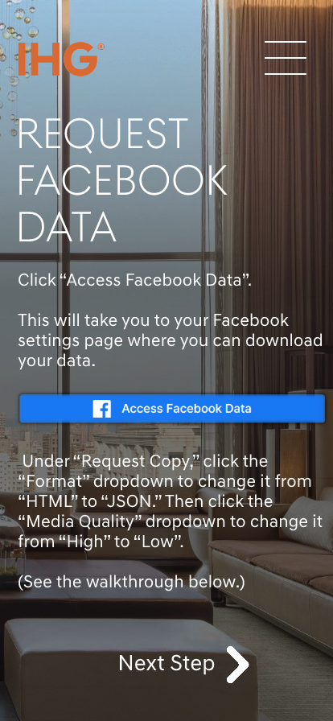

Step 2: Uploading Data
The user is brought through the process of how to download their information from the social media platform they logged in with.
We provide a simple drag and drop upload solution that works on both desktop and mobile.
The user is automatically brought to the final step once the upload is completed.

Slide 6
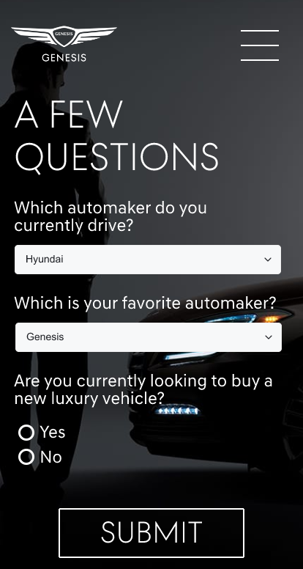
Step 3: Customer Survey
As a value-added feature, we include a customer survey with questions supplied by the brand. This is their opportunity to ask important questions of their customers and discover new insights.
Survey results are automatically associated with social media.
After this step is completed the user is informed that their data will be reviewed and that a prize will be issued within a certain timeframe.
Consent for data collection is obtained when the survey is completed.

Slide 7
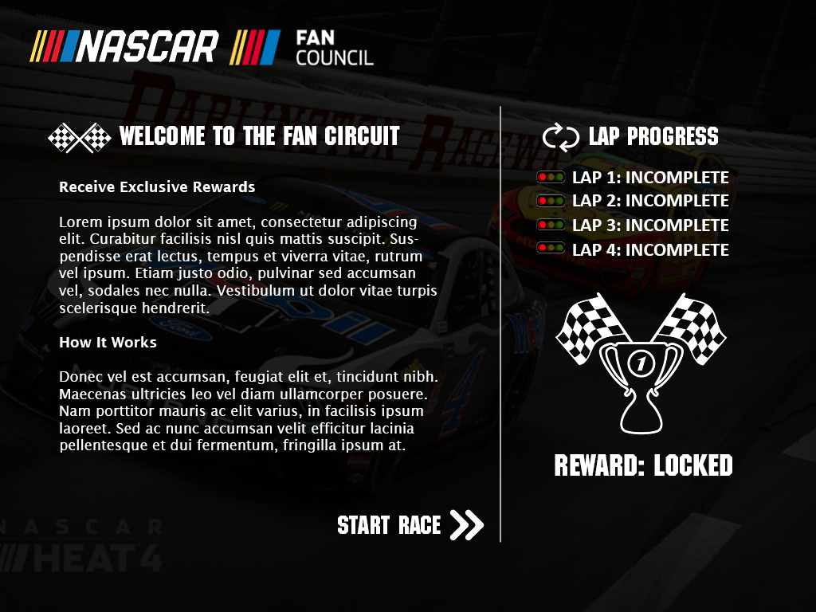
Alternate Example: Gamified Experience
Datalucent can implement gamification techniques to help guide the user through the process in a relaxed and fun environment.
This is a sample Datalucent produced for Nascar.
Tracks Progress
Reward Status
Starts Process

Slide 8

Data Results

Slide 9
Benefits & Features
All data is stripped of personally identifiable information and normalized into a structured database.
This database can be accessed through the brand’s business intelligence tool of choice via our API.
The information is secure, compliant, and risk-free for the brand.

Slide 10

Consumer Data Anatomy
Demographics
Media Preferences
Datalucent can provide deep and accurate information about each user.
The data can show each user’s favorite TV shows, music artists, genres, and platforms.
Age: 32
Language: English
Gender: Male
Favorite Media:
Billie Eilish
Playstation 4
The Tonight Show
The Bachelor
Rock & Roll
Gaming Preferences
Non-gaming Interests
The data shows each fan’s unique set of interests within gaming.
The data also shows information about each user’s interests outside of gaming.
Gaming Interests:
League of Legends
Pokemon GO
Overwatch League
Sonic Mania
Nintendo Switch
Other Interests:
Financial news
Government
Sci-fi and Fantasy
Massachusetts
Online Education

Slide 11
Learn Adjacent Interests and Markets
Deepen your understanding of your fans’ most interests. Discover niche marketing opportunities. Find prospective areas to build new audiences.
Streaming Video
Outdoors
Equipment
Sports
Group A
Group B
Games
Pet Supplies

Slide 12
See Changes Over Time
Datalucent tracks users over time.
The data shows when individuals interact with content and how engaged they are with brands.
BI tools can highlight how users became customers of a given brand and produce leads for new customers.
Not a fan
New Fan
Full Fan
Time
Mark
Video Game
Follows Twitter Accounts
Subscribes
Purchases
Players & Teams
Gaming
YouTube Channel

Slide 13
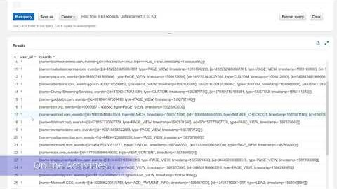

Slide 14

Our Advantages
Avoid huge data liability. We assume the risk of data storage and compliance.
Make sense of your data. We provide meaningful insights and deepen your understand of your fans.
See outside perspectives. Take advantage of comparisons across other properties.
Gain a strategic asset. We help identify sponsors, brands, and affiliate audiences.
Acquire actionable information. We help build and improve your marketing strategies.

Slide 15
Open Questions & Notes
Should I include conversion rates?
Will this process resonate with Sega? If so should I create a fully branded Sega customer experience?
We can provide videos of the entire process branded for Sega. Is there a preference for desktop or mobile?
Note: I can find gaming specific data and provide that in the presentation.

Slide 16



















Compiled social data enables Datalucent to build and execute high-response customer panels across all major channels
CLIENT
DATA
PROGRAMMATIC
ADVERTISING
DATA LAKE
CONSUMER
SOCIAL DATA
PII
PII
Sample Data
(No PII)
PII
SEARCH
ADVERTISING
PII
Matched on
Consumer PII
PII
PARTNER
DATA
PII
PII
Audience
Algorithm
PII
PII
3RD PARTY
DATA
SOCIAL
ADVERTISING

Slide 17
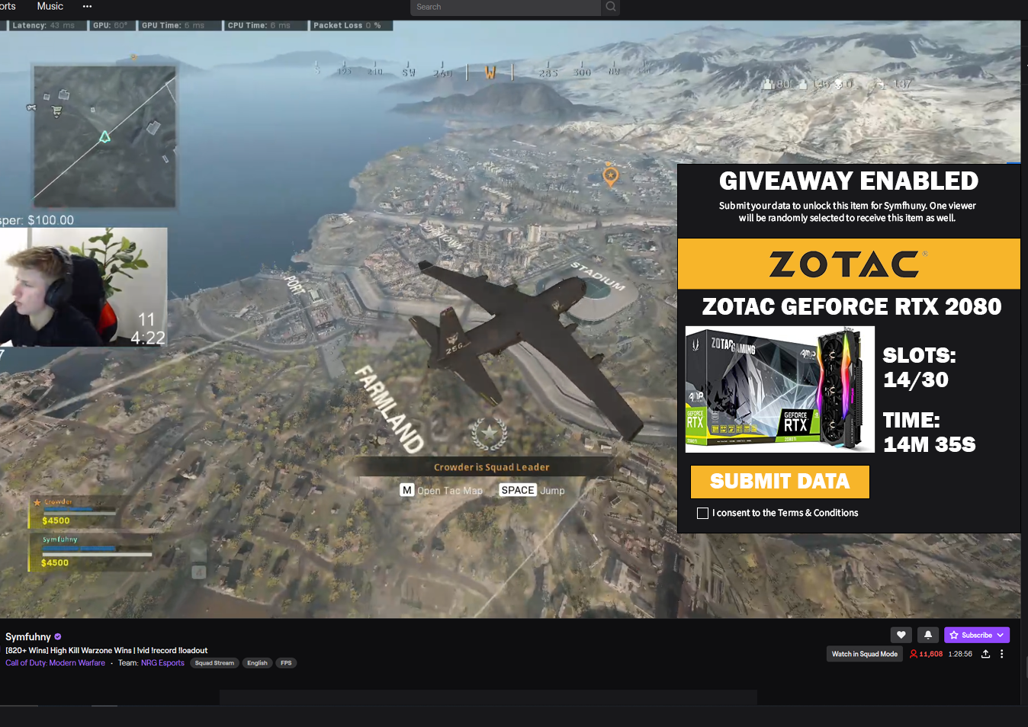
Example Twitch Overlay

